Slide 1

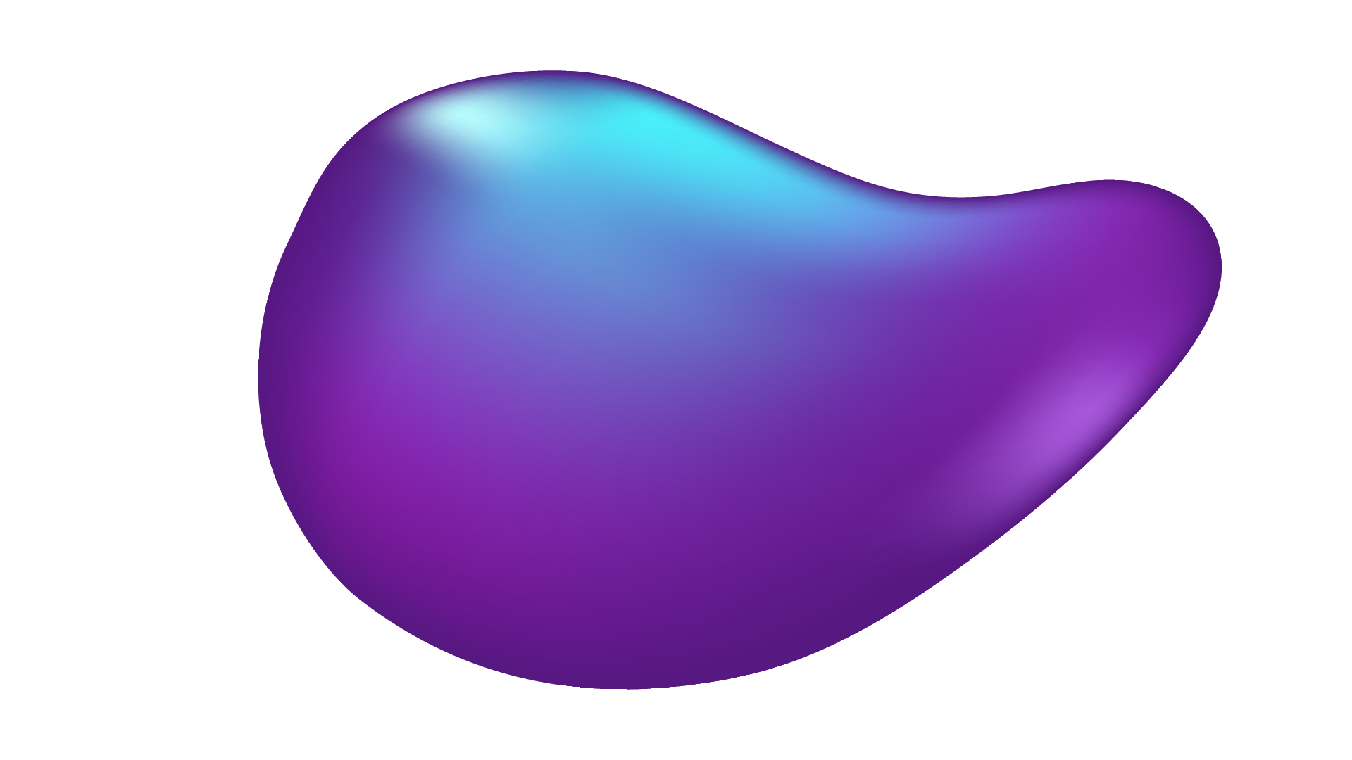

ARTIFICIAL INTELLIGENCE (AI)
Machine learning
Diabetes Analysis

Slide 2




Slide 3
Made By:

Slide 4
Youssef Ahmed

Slide 5
Abdelrahman
Emad

Slide 6
Abdelrahman Mohamed

Slide 7
Under supervision of : DR. Mohamed Abdelraouf

Slide 8
AGENDA
01
02
03
04
05
INTRODUCTION TO AI
A description of the AI
INTRODUCTION TO DATASET
A description of the dataset
DATASET ATTRIBUTES
Explaining the main features
CSV DATA PROCESSING
Demonstrating the main steps
IMAGE PROCESSING
Transforming images into a digital form

Slide 9


01
INTRODUCTION TO AI
A description of the AI

Slide 10
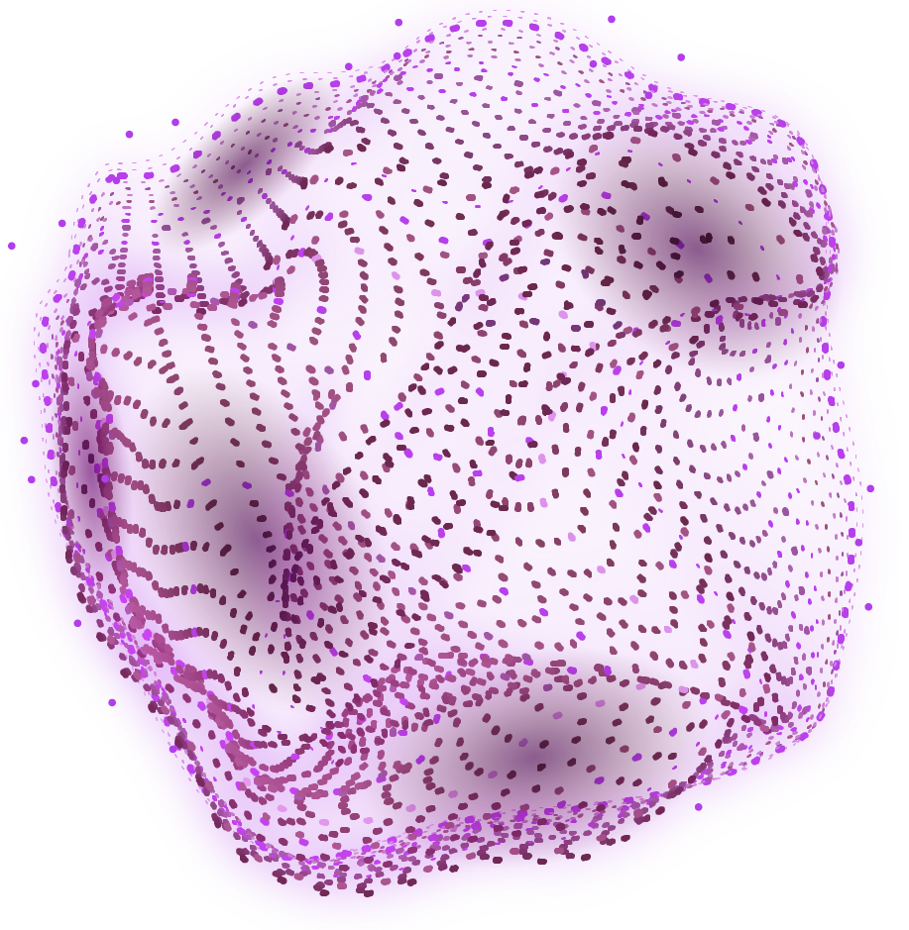
Artificial intelligence (AI) is a machine that's able to learn, make decisions, and take action even when it encounters a situation it has never come across before and one of its most popular branches is machine learning
WHAT IS ARTIFICIAL INTELIIGENCE??

Slide 11
WHAT is the Machine Learning?
Machine learning is a branch of artificial intelligence (AI) and computer science which focuses on the use of data and algorithms to imitate the way that humans learn, gradually improving its accuracy.

Slide 12
STEPS OF APPLYING MACHINE LEARNING
01) GETTING A DATASET
02) IMPORT DATASET
To orange app
03) DATASET ANALYSIS
04) DATASET CLEANSING
understanding the dataset
To be ready for use
05) Applying the model

Slide 13
02
INTRODUCTION TO DATASET
A description of the dataset

Slide 14
The Diabetes prediction dataset is a collection of medical and demographic data from patients, along with their diabetes status (positive or negative). This dataset can be used to build machine learning models to predict diabetes in patients based on their medical history and demographic information.
EXPLANATION OF DIABETES DATASET:

Slide 15
03
DATASET ATTRIBUTES
Explaining the main features

Slide 16
DATASET ATTRIBUTES
The data includes features such as age, gender, body mass index (BMI), hypertension, heart disease, smoking history, HbA1c level, and blood glucose level.

Slide 17
04
CSV DATA PROCESSING
Demonstrating the main steps

Slide 18
ORANGE DATA MINING
01) UNDERSTANDING DATASET
02)
PREPARING
TRANING
PHASE
03)TRANING,TESTING AND PREDECTION

Slide 19
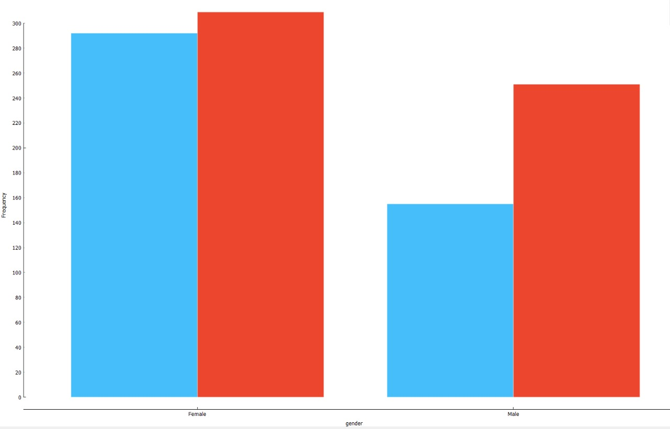
01) UNDERSTANDING DATASET
DISTRUBUTIONS :
It represents the features in charts

Slide 20
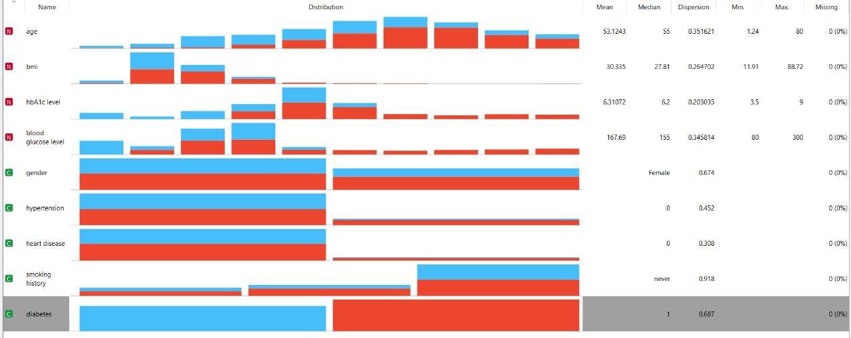
01) UNDERSTANDING DATASET
FEATURE STATISTICS:
shows basic statistics for each feature like max, min, mean, median and missing values

Slide 21
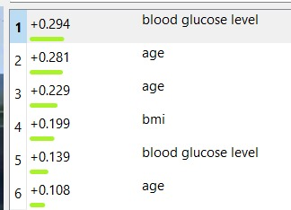
01) UNDERSTANDING DATASET
CORELLATION:
states whether there is a direct or inverse relation between features . the positive values means direct relation while negative values means inverse

Slide 22
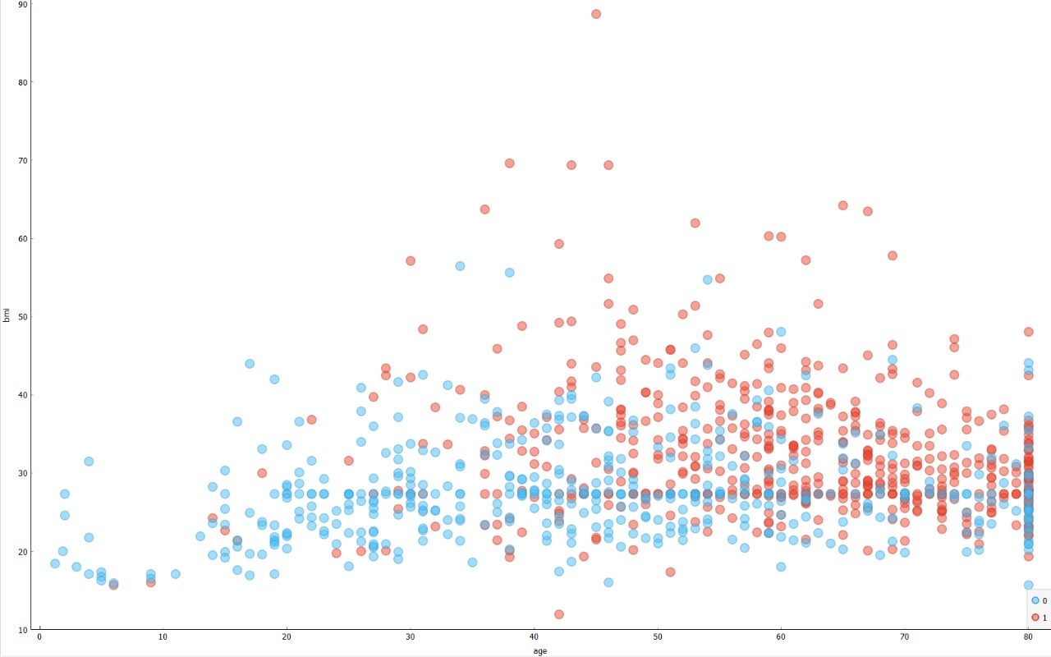
01) UNDERSTANDING DATASET
SCATTER PLOT:
displays the distribution of any two numeric features in x-y axis

Slide 23
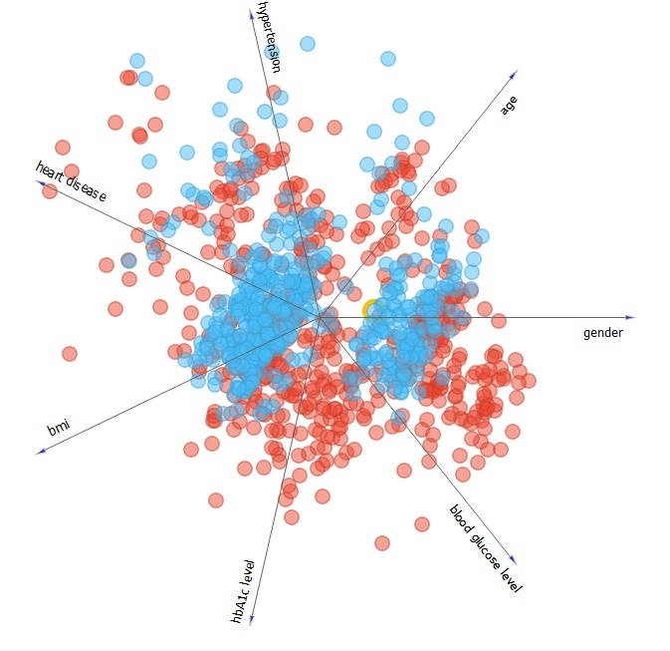
01) UNDERSTANDING DATASET
FREE FIZZ:
displays the most effective features on target graphically

Slide 24
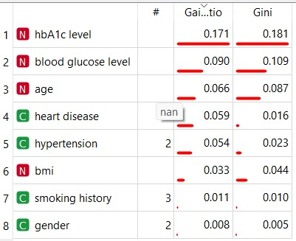
01) UNDERSTANDING DATASET
RANK:
displays the most effective feature in target numerically

Slide 25
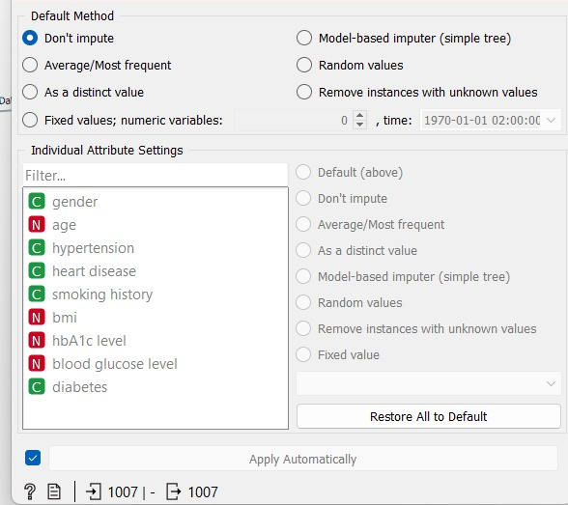
02)PREPARING FOR TRANING PHASE
IMPUTE:
substitutes ant missing value using several methods this step will help you not to lose any record

Slide 26
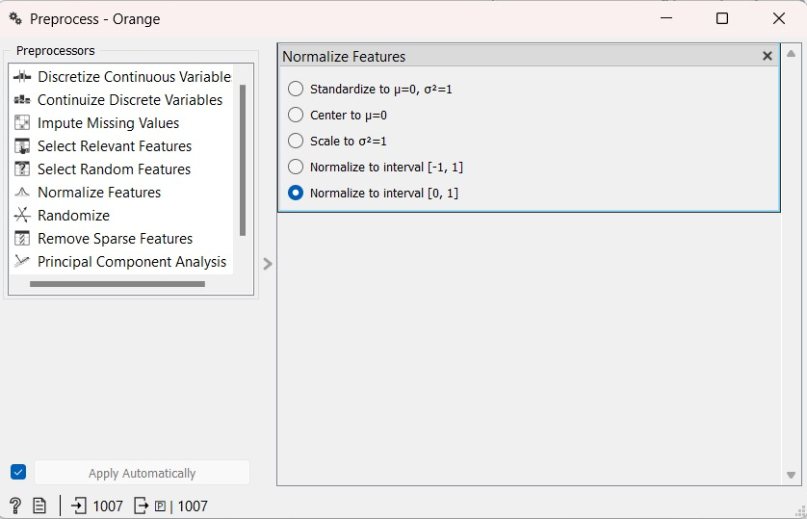
02)PREPARING FOR TRANING PHASE
PREPROCESS:
normalize any numeric field to a range from 0 to 1 this step will increase the efficiency of analyzing the dataset and increase the accuracy

Slide 27
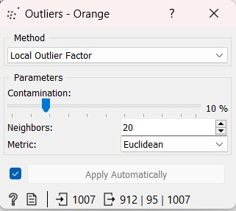
02)PREPARING FOR TRANING PHASE
OUTLIERS:
removes any abnormal records that will affect both training and prediction phases

Slide 28
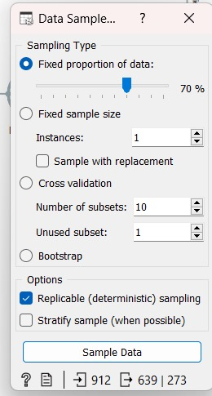
02)PREPARING FOR TRANING PHASE
DATA SAMPLER:
divides the datasets into two proportions and remaining

Slide 29
03)TRANING TESTING AND PREDECTION
We used the following models to know the highest CA and connected them to test and score to compare between accuracies:
KNN
RANDOM FOREST
RANDOM NETWORK
NAÏVE BAYES
SVM
TREE

Slide 30
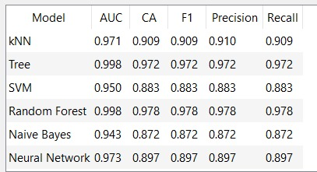
03)TRANING TESTING AND PREDECTION
As shown in the screenshot (Random Forest has the highest accuracy)

Slide 31
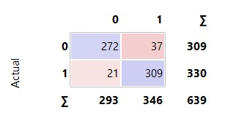
03)TRANING TESTING AND PREDECTION
CONFUSION MATREX:
Shows cases that happened confusion in them

Slide 32
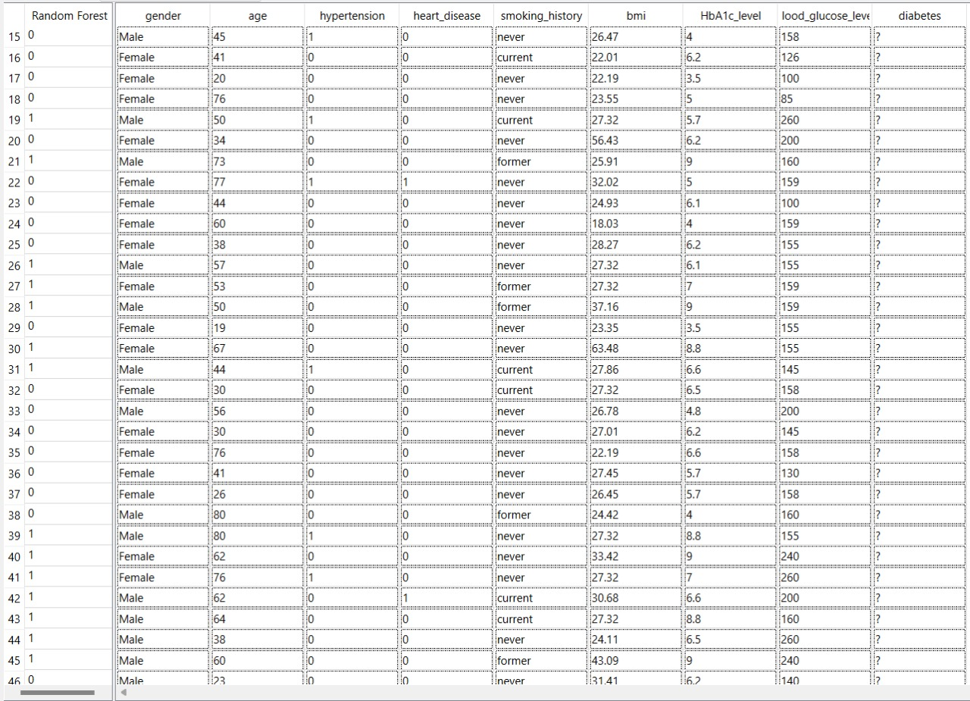
03)TRANING TESTING AND PREDECTION
PREDECTIONS:
We connected the highest accuracy model to the predictions and compare original target results with the predictions of random forest

Slide 33
05
IMAGE PROCESSING
Transforming images into a digital form

Slide 34
IMAGE PROCESSING STEPS
01)FINDING DATASET
02)TRANING THE DATASET
03)PREDECTION BY SAVED MODEL

Slide 35
THANKS!

